Slide 1
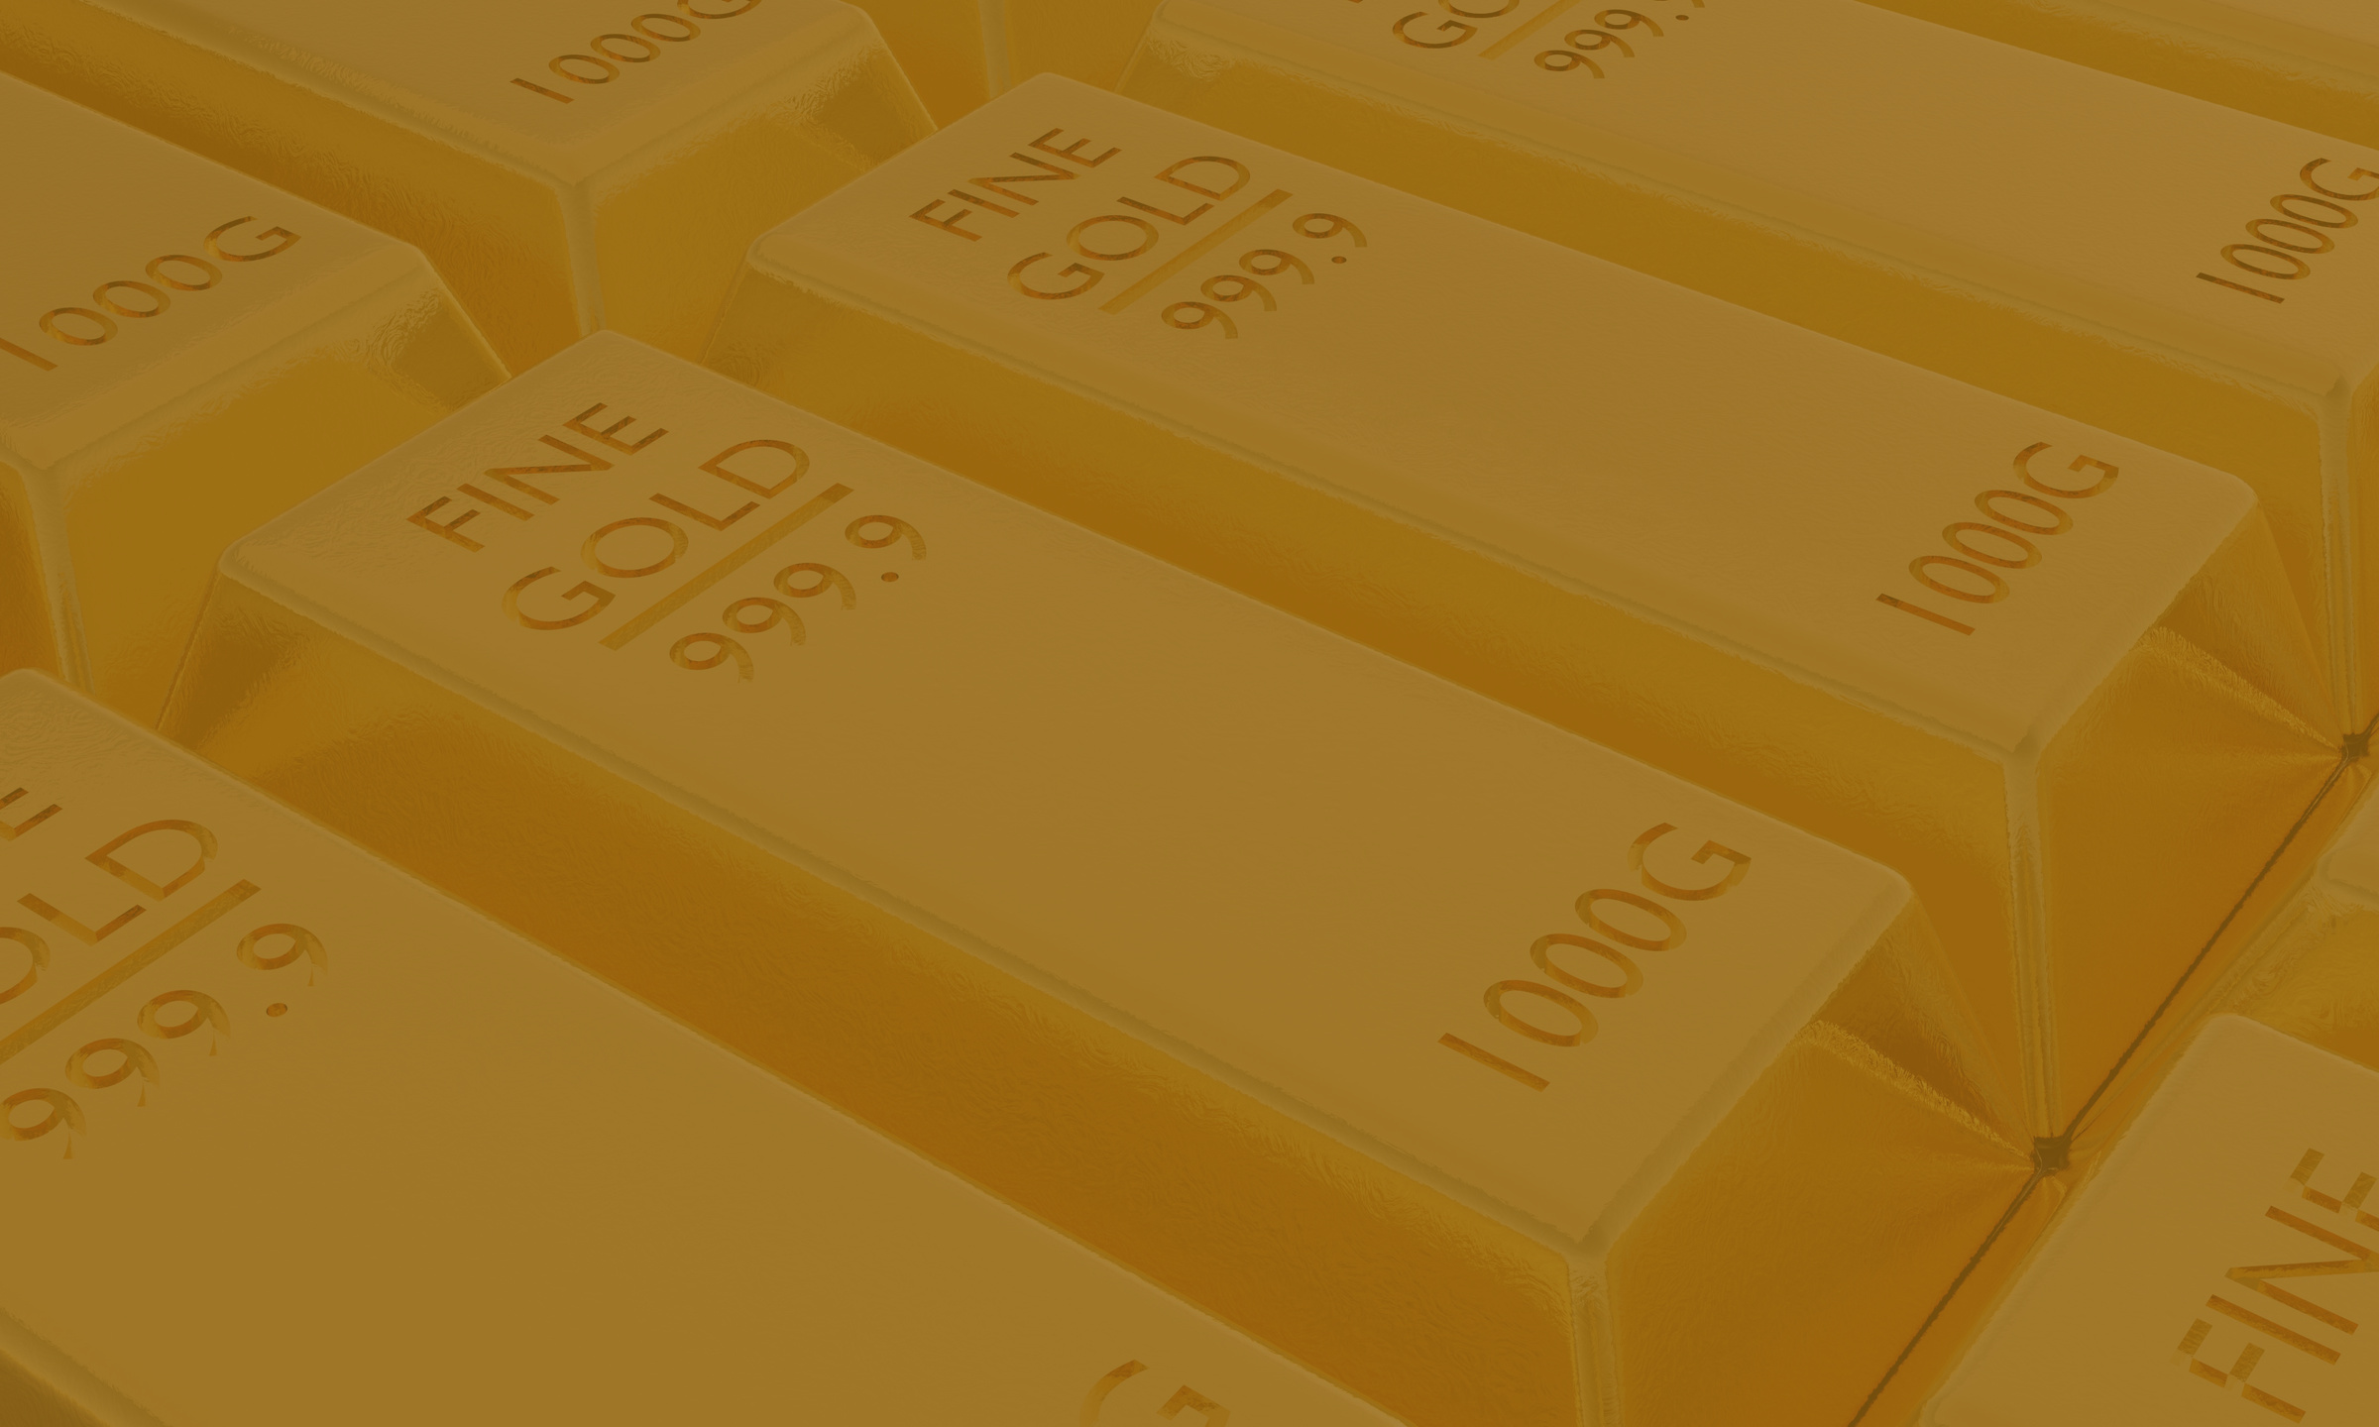

HARIPRIYA & SALONI
Interlinkages and Price Dynamics among Gold ETFs, Sovereign Bonds and Physical Gold in India
Notes:
Slide 1 — Title Slide
Haripriya:
Our paper is titled “Gold as a Financial Asset in Transition : Comparative Evidence from Sovereign Gold Bonds, ETFs, and Physical Holdings in India.” Our central idea is to understand how India’s traditional love for gold has evolved — from wearing it as jewelry to holding it as a financial asset.

Slide 2

INTRODUCTION
Why Study Gold Investments?
Gold has held a unique place in India both culturally and economically.
Beyond its ornamental value, gold has been a store of value, a hedge against inflation, and a safe-haven asset during financial crises.
According to the World Gold Council, India accounts for around 25% of global gold demand which the country meets almost entirely through imports, contributing to a widening current account deficit (CAD) and currency pressure.
Non-physical forms of gold like Sovereign Gold Bonds (SGBs) and Gold ETFs aim to modernize this tradition, offering the shine of gold without the burden of imports.
Our paper examines the empirical relationships between these two instruments and gold.
Notes:
________________________________________
Slide 2 — Introduction
Saloni:
Gold has always had a unique place in India — not just culturally, but economically.
For generations, families have treated gold as a store of value, a hedge against inflation, and a safe haven in uncertain times. But India meets almost all its gold demand through imports.
That pushes up our current account deficit and can even weaken the rupee.
To address this, newer options like Sovereign Gold Bonds (SGBs) and Gold ETFs have emerged : offering the shine of gold without the burden of imports.

Slide 3
Understanding Gold Investment Instruments
Sovereign Gold Bonds (SGBs)
Gold Exchange-Traded Funds (ETFs)
(SGBs = Safe, interest-earning alternative to physical gold.)
(ETFs = Liquid, market-linked gold exposure.)
Issued by the Government of India and managed by the RBI.
Represent digital gold ownership – no physical gold involved.
Offer 2.5% annual interest (paid semi-annually) + price appreciation.
Tenure: 8 years (exit allowed after 5).
No storage or purity risk, and capital gains are tax-free if held till maturity.
Traded on stock exchanges like NSE/BSE.
Each unit = roughly 1 gram of gold, backed by physical gold.
Prices fluctuate daily — ideal for short-term trading or portfolio liquidity.
No interest income, but easy to buy/sell.
Subject to capital gains tax like other mutual funds.
Notes:
Slide 3 — Understanding Gold Investment Instruments
Haripriya:
Let’s quickly compare these two modern investment forms.
SGBs are issued by the Government of India and managed by the RBI.
They represent digital gold ownership.
You get a 2.5% annual interest, along with price appreciation, and they’re completely tax-free if held till maturity.
In contrast, Gold ETFs are traded on exchanges like NSE and BSE.
Each unit equals about one gram of gold and reflects daily market prices.
They’re great for short-term liquidity and trading, though they don’t pay interest.
So in short —
SGBs are safe, interest-earning, and ideal for long-term investors,
while ETFs are liquid, market-linked, and better for short-term flexibility.

Slide 4
RESEARCH OBJECTIVE
To compare the returns and volatility of SGBs, ETFs, and Physical Gold.
To evaluate liquidity and investor suitability of each instrument.
To identify which instrument offers the best risk-adjusted performance for different investor types.
To understand the policy implications of promoting financial gold over physical holdings.
Notes:
Slide 4 — Research Objective
Saloni:
Our study had four clear objectives:
1. To compare returns and volatility of SGBs, ETFs, and Physical Gold.
2. To assess liquidity and see which suits different investors.
3. To find which one offers the best risk-adjusted performance.
4. And finally, to draw policy implications — how financial gold can reduce our dependence on imports.
So essentially, we’re testing — which form of gold investment works best, and for whom?

Slide 5

DATA DESCRIPTION
Data and Variables
Data Period: January 2015 – October 2025
Sovereign Gold Bonds (SGBs) – daily prices from RBI/secondary market
Gold ETFs – daily trading prices from NSE
Physical Gold – daily gold futures prices (USD), converted to INR using exchange rate data (Yahoo Finance).
This ten-year window captures both crises and recovery — perfect for testing how resilient each form of gold investment really is.
Notes:
Slide 5 — Data and Variables
Haripriya:
For this, we used daily data from June 2020 to May 2025, covering around five years.
The period is interesting — it includes post-COVID market cycles, so we get to see how resilient each instrument is during both crisis and recovery.
Our data came from the RBI and NSE, with key variables like closing prices and log returns.
We used Excel for cleaning and Python for analysis.

Slide 6
Summary statistics
All three instruments showcased an upward trend which indicates the global rise in gold prices driven by multiple macroeconomic events.
SGB price series were comparatively smoother and less volatile whereas Gold ETFs and physical gold show greater sensitivity to daily global shocks.
The surge in volatility during 2020-2021 was most evident in ETFs and least in SGBs.
Even it gradually decilned for all three instruments, in the long run ETFs tend to be the most volatile.

Slide 7

METHODOLOGY
Collect
“Turning Raw Data into Financial Insights”
Two datasets were derived: Daliy returns data and Price index data.
Data cleaned, aligned by trading dates, and merged for consistency.
Regression analysis and correlation measures were applied to understand basic relationships between the variables.
ARCH and ADF tests were conducted to detect volatility clustering and to confirm the stability of return series over time.
Granger causality analysis was used to assess whether movements in gold prices influence SGBs and gold ETFs in the long run.
Finally, the Johansen cointegration test was employed to determine whether these assets share a stable long-term equilibrium relationship.
Clean
Analyze
Visualize
Notes:
Slide 6 — Methodology
Saloni:
Our process had four main steps — Collect, Clean, Analyze, and Visualize.
We gathered daily price data for all three instruments, standardized and aligned the trading dates, and then computed log returns to capture daily performance.
We also measured 30-day rolling volatility to understand short-term risk, and cumulative returns to evaluate long-term growth.
Then we analyzed correlations and risk–return patterns to see how they move together.
All the analysis and graphs were done in Python
________________________________________

Slide 8
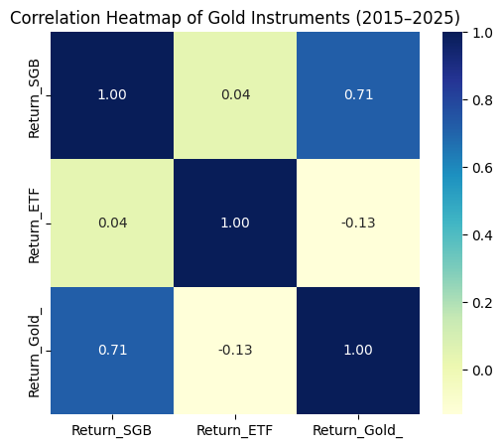
RESULTS
Correlation :
The SGB–Gold correlation of 0.71 shows that they usually move in the same direction.
The ETF–Gold correlation of –0.13 implies ETFs behave differently because they react quickly to daily market movements.
SGBs follow the general trend of gold but have smoother returns because they earn interest and are traded less often.
This smoother movement makes SGBs useful for reducing risk in a gold-focused portfolio while still keeping good returns.
SGBs work like gold with added stability, thanks to their fixed interest and lower volatility.

Slide 9


Regression Analysis
Model Setup :
Dependent variables: SGB Returns, ETF Returns 2. Independent variable: Gold Returns
Model 1: SGB on Gold Returns
Model 2: ETF on Gold Returns
A 1% rise in gold returns leads to a 0.77% rise in SGB returns.
Highly significant (p < 0.001), R² = 0.51 → gold explains about half of SGB movements.
Remaining variation comes from interest income and lower trading activity, which make SGBs smoother.
A 1% rise in gold returns leads to a 0.88% rise in ETF returns.
Highly significant (p < 0.001), R² = 0.74 → gold explains 74% of ETF movements.
ETFs move almost one-to-one with gold, showing strong price responsiveness.

Slide 10
ARCH Test
The ARCH test was conducted to check whether the returns of SGBs, Gold ETFs, and Physical gold exhibit volatility clustering. The results show:
p-values: SGB = 0.33, ETF = 0.19, Gold = 0.87
All p-values > 0.05 → no volatility clustering
Return spikes are isolated, not persistent
Movements are relatively stable and random
Johansen Cointegration
The Johansen test is used to check whether SGBs, ETFs, and physical gold share a stable long-run price relationship, even though their short-term movements differ.At least one cointegrating relationship among SGB, ETF & Gold
The test showed a long-run equilibrium despite short-term differences
Prices eventually converged back to a common trend
The results reflected growing financialization of gold markets
Indicates India is shifting from gold as consumption → to gold as investment

Slide 11
Granger Causality
The Granger test is used to check whether past values of one variable can help predict another variable.
The results show that :
Gold returns predict SGB returns at a one-period lag (p = 0.031)
SGB prices adjust with a slight delay
Gold does not Granger-cause ETF returns (p > 0.75)
ETFs react instantly due to higher liquidity and active trading
ADF Test
The ADF test is used to check whether a time series is stationary, meaning its mean and variance remain stable over time.
The results show :
All return series have p-values < 0.01
Returns are stationary, mean-reverting, and stable
Suitable for regression, causality, and time-series analysis

Slide 12

CONCLUSION
All three instruments are linked but behave differently in the short run
ETFs: strongest reaction to gold price changes; highly liquid and efficient
SGBs: smoother returns due to fixed interest and lower trading frequency
SGBs bridge the gap between traditional gold and modern financial gold
ETFs suit active investors; SGBs suit long-term, risk-averse savers
Together, SGBs and ETFs modernize gold savings and reduce reliance on imports
SGBs combine the stability of fixed-income with the value of gold
The shift toward financial gold instruments reflects India’s evolving investor mindset from preserving wealth to managing it intelligently.
Notes:
Slide 11 — Conclusion
To wrap up — gold continues to hold a timeless emotional and financial value in India.
However, the way we invest in it is evolving.
Our findings indicate that SGBs offer the most balanced option — combining safety, returns, and a contribution to the formal economy.
ETFs modernize access to gold and provide liquidity for market-savvy investors.
Physical gold, while sentimental, has become less efficient due to its costs and risks.
Overall, India is shifting from merely preserving wealth through gold to managing it intelligently through financial gold instruments.

Slide 13
Thank You !

